Slide 1
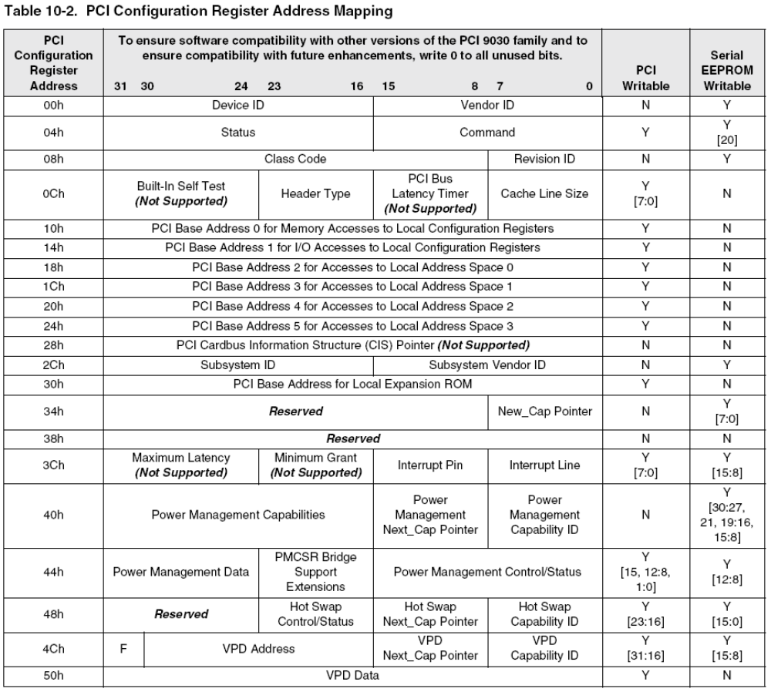
PCI System Architecture

Slide 2
PCI System Architecture
Max_Latency, Min_Gnt and Latency Timer: (Page 61, 79)

Slide 3
PCI System Architecture
Bus Access Latency:
Arbitration Latency:
Bus Acquisition Latency
Initiator and target Latency

Slide 4
PCI System Architecture
Master Transfer Data Delay:
First Data Complete Delay:

Slide 5
PCI System Architecture
Through Put Examples:
Multiple devices requesting the bus – What is the throughput of device one if - one device with a latency_timer of 10 and a second device with a latency_timer of 12

Slide 6
PCI System Architecture
Through Put Examples:
Multiple devices inserting wait states – What is the throughput for a deivce that is the only device on a bus and the target inserts one wait state every other data transfer and the initiator inserts one wait state every third data transfer:

